Slide 1
LIBRARY MANAGEMENT SYSTEM

Slide 2
ABSTRACT
Library Management Systems are a great way to monitor books, add them, update information in it, search for the suitable one, issue it, and return it when needed. This Library Management System Project is developed in Java, to provide all the features that a Library Management System should usually have and overcome the drawbacks of the present system such as:
he Library Management System is an application for assisting a librarian in managing a book library in a university. The system would provide basic set of features to add/update members, add/update books, and manage check in specifications for the systems based on the client's statement of need.

Slide 3
HARDWARE SPECFICATION
Processor : P 4 700 GHz.
RAM : 4 GB RAM
Hard Disk Drive : 180 GB

Slide 4
SOFTWARE SPECIFICATION
Operating System : Windows 7/8/10
Front End : JAVA
Back End : ORACLE

Slide 5
EXISTING SYSTEM
The current Library Management System does not eliminate the process of searching books within the library campus. Students have to find books manually. They have to wait until they are not provided with their library card and token. For receiving book they have to show their library card and wait in line for their turns. The admin personnel also have to look manually on which day which person will take the charge within library to manage the overall work.
Disadvantages
Paper-based record keeping.
Mis-management of data due to manual and paper-based handling.
A vast amount of time consumption in searching for books and library management.
Book-thefts from the library.

Slide 6
PROPOSED SYSTEM
A library management system with functionalities to issue, return, and view the status of books should be user friendly enough so that the person handling it can get the work done efficiently. It is such that people who haven’t used software earlier can also work on it efficiently without knowing any technicalities.
Advantages
Easy to Handle the user details
Track the book details accordingly
Very user friendly to handle the software

Slide 7
Modules
Add user
To add a new user to the program, click on ‘add user’ and select whether it is an admin or user to continue. The details of all users will be displayed in the view users’ section.
Issue a book
To issue a book to a student/member/user, you need to click on the ‘issue book button’ with the book details like book id, user id, number of days to be issued, date of return, etc. After entering the required information, click on ‘submit’ which completes the process. Depending on the process you need for issuing a book or providing access to users to view the list of books, you can change the logic as desired. If you need to provide access for particular users to view the list of some selected books available in the database, some changes to the logic need to be done.

Slide 8
View issued books
After you issue the book with the process mentioned in the above paragraph, all the issued books with respective details can be viewed with this functionality.
Return Books:
After selecting the return books option, you need to enter the book id and select the return date from the calendar selection. There are two variations to this: If the book is returned on time, then it will display the message of the book returned. If the book is returned later than the mentioned date, the system will display the message of the fine payment with the amount to be paid. The details of the fine payment can also be viewed in ‘View issued books’.
Add Book:
Adding the book to the system can be done here with all the details of the book, name, price, genre, etc. It can be viewed in the ‘view books’ section thereafter.

Slide 9

Data Flow Diagram
Level 0

Slide 10
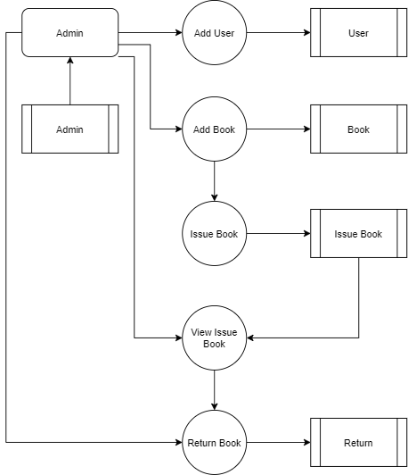
Level 1:

Slide 11
Thank You

